Slide 1

UE20CS390B – Capstone Project Phase – 2
Project Progress Review # 2
Project Title : Deploy EOX microservices using cloud platform service and improve scalability.
Project ID : PW_23_VP_01
Project Guide : Prof Venkatesh Prasad, Mr.Vijay R(EOX Vantage)
Project Team : Veena Garag PES1UG20CS492
Adarsh Kumar PES2UG20CS016
Suchit S Kallapur PES1UG20CS438
Yuvaraj D C PES1UG20CS521

Slide 2
Deploy eox microservices using cloud platform service and improve scalability.
Suggestions from Review 1
We were expected to deploy the demo application on a live server.
Implementation of custom pod scaling algorithm

Slide 3
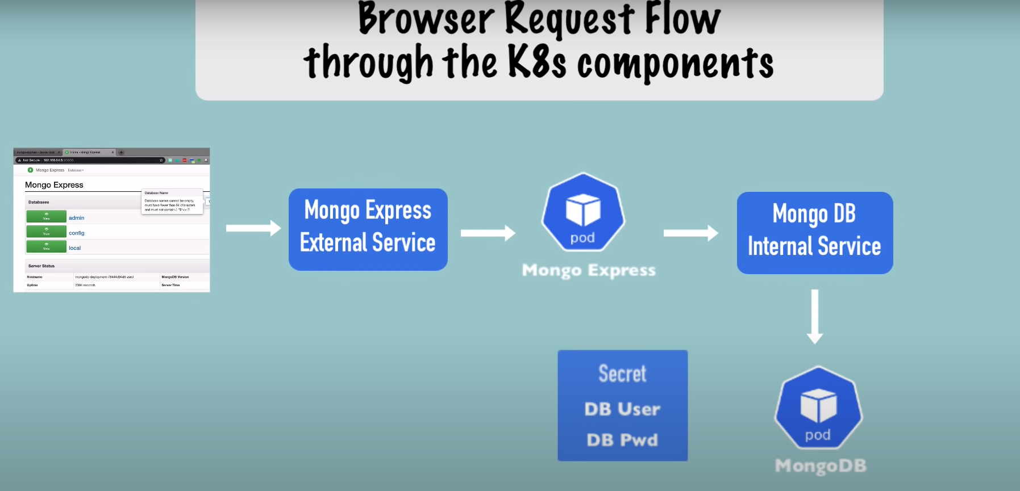
Deploy eox microservices using cloud platform service and improve scalability.
DEMO: MongoDB Application Deployment
Diagram of a browser request flow through the Kubernetes (K8s) components for a MongoDB application using Mongo Express.
Internal flow of request to MongoDB through Mongo Express

Slide 4
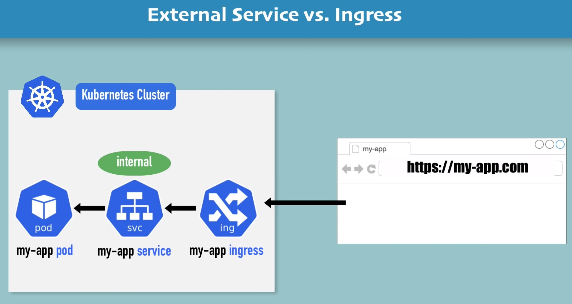
Deploy eox microservices using cloud platform service and improve scalability.
MongoDB Application Deployment
Deployment of application using Ingress controller instead of External service
Kubernetes cluster with two Pods: my-app and my-ingress.
The my-app Pod is a regular Pod that runs the application.
The my-app external service is a LoadBalancer service that exposes the my-app Pod to the outside world.
The my-ingress Pod is an Ingress controller. Ingress resource is a Kubernetes resource that defines how traffic should be routed to the my-app external service.

Slide 5
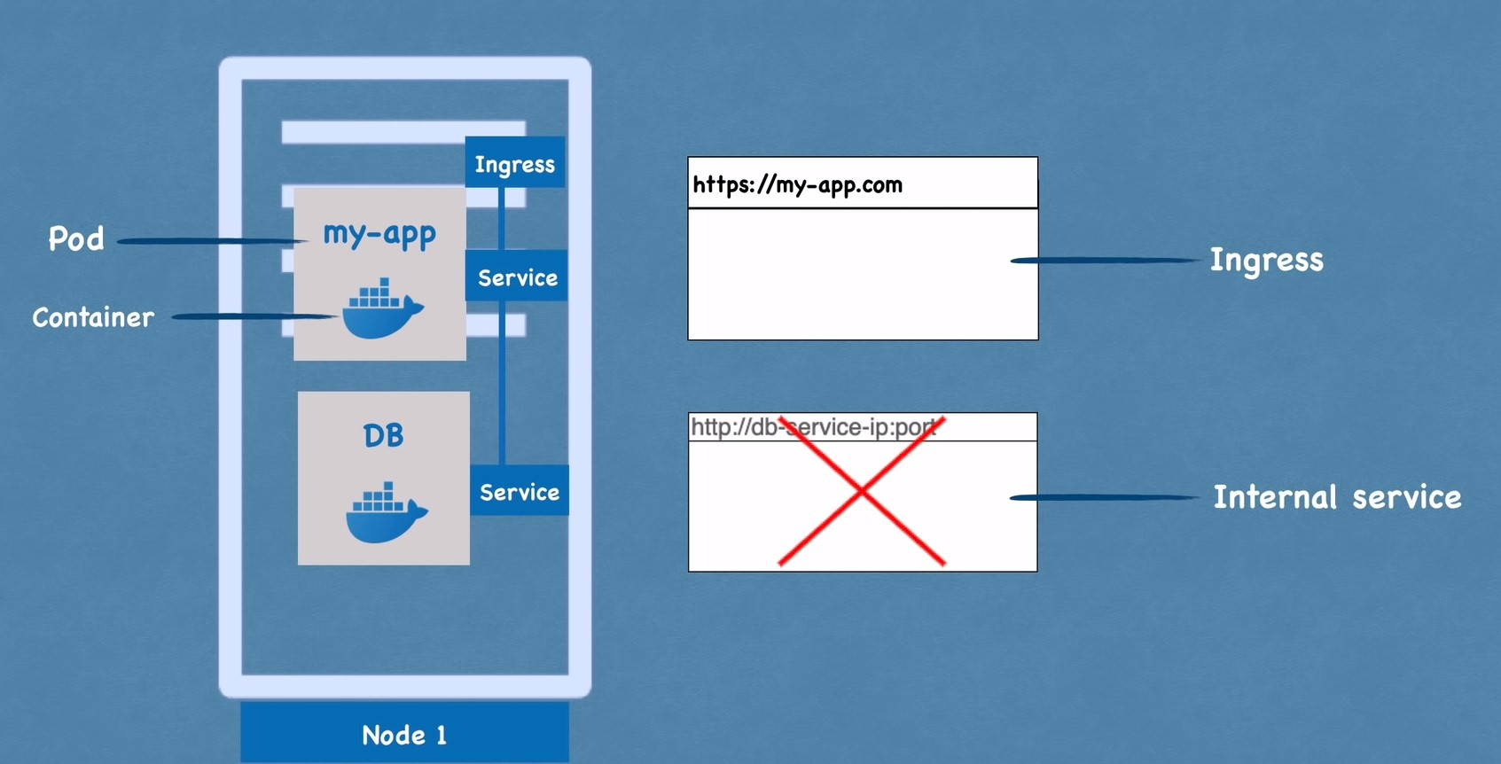
Deploy eox microservices using cloud platform service and improve scalability.
MongoDB Application Deployment
Accessing applications using domain names

Slide 6
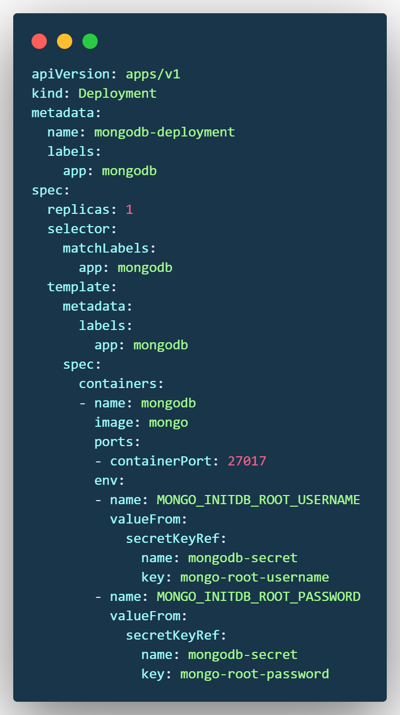
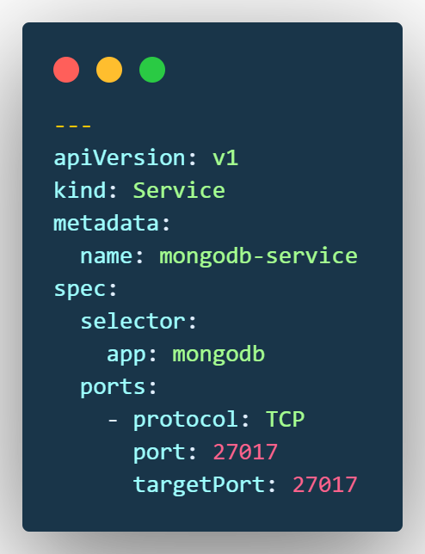
Deploy eox microservices using cloud platform service and improve scalability.
Code
Each configuration file has 3 parts:
Metadata
Specification
Status
mongo.yaml

Slide 7
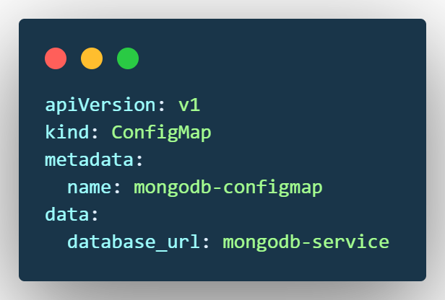
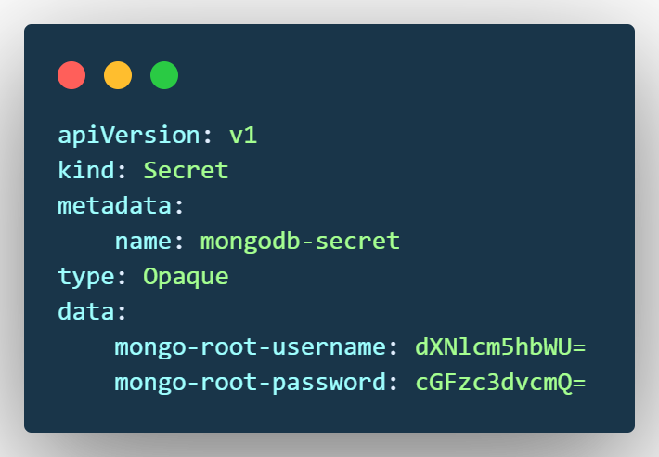
Deploy eox microservices using cloud platform service and improve scalability.
Code
mongo-configmap.yaml
mongo-secret.yaml
A Secret is an object in Kubernetes that stores sensitive data such as passwords, tokens, and keys.
Secrets are stored in base64 encoded form and can be accessed by Pods and other Kubernetes objects.

Slide 8
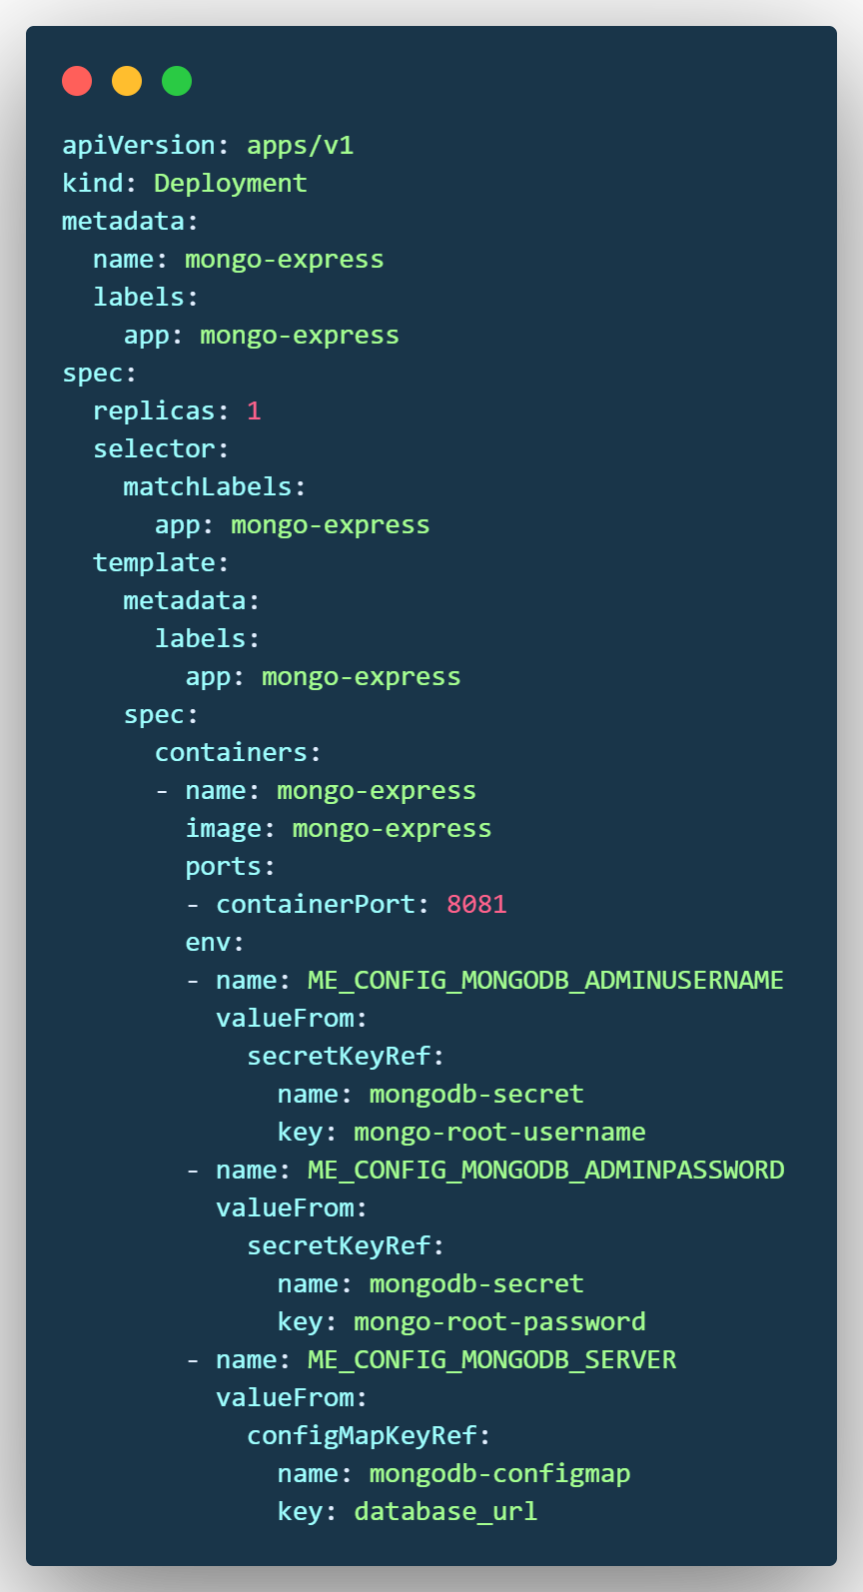
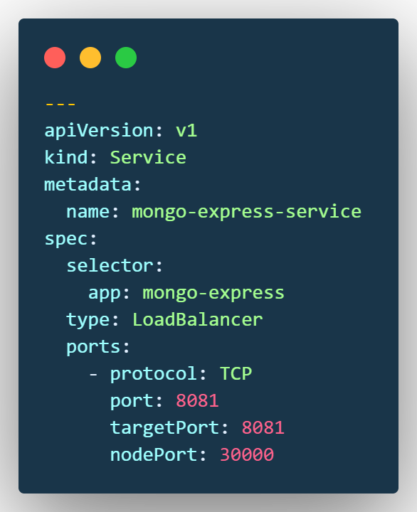
Deploy eox microservices using cloud platform service and improve scalability.
Code
mongo-express.yaml

Slide 9
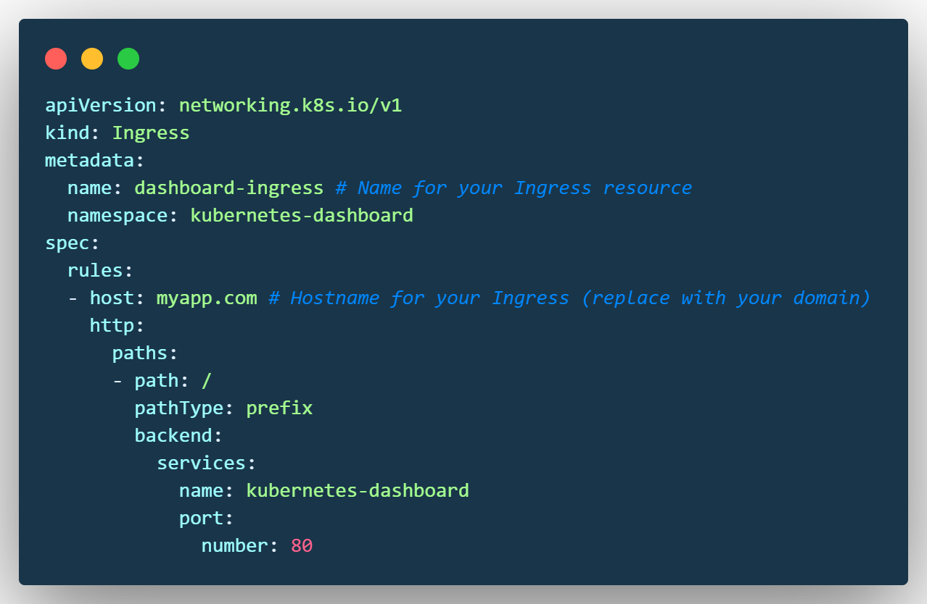
Deploy eox microservices using cloud platform service and improve scalability.
Code
Ingress resource that defines how traffic should be routed to your application.
The Ingress resource is a way to expose your application to the outside world, and it can be used to route traffic to specific services based on the path of the request, the hostname.
dashboard-ingress.yaml

Slide 10
Deploy eox microservices using cloud platform service and improve scalability.
Conclusion
As expected by EOX we have deployed an MongoDB Mongo Express application onto their live server and successfully accessed it using the domain name using ingress controller instead of IP address and port number.
Task for Review 3
Implementation of Custom pod scaling algorithm

Slide 11
Deploy eox microservices using cloud platform service and improve scalability.
References
Deshpande, Neha (2021) Autoscaling Cloud-Native Applications using Custom Controller of Kubernetes.
https://norma.ncirl.ie/5089/
Masters thesis, Dublin, National College of Ireland.
Shitole, Abhishek Sanjay (2022) Dynamic Load Balancing of Microservices in Kubernetes Clusters using Service Mesh.
https://norma.ncirl.ie/5943/
Masters thesis, Dublin, National College of Ireland.
An Efficient and Scalable Traffic Load Balancing Based on Web Server Container Resource Utilization using Kubernetes Cluster.(May – 2022) Ashok L Pomnar,
AVCOE Sangamner 422 605,Maharashtra, India.
https://ijisrt.com/assets/upload/files/IJISRT22MAY1644_(1)_(1).pdf
V. Sharma, "Managing Multi-Cloud Deployments on Kubernetes with Istio, Prometheus and Grafana," 2022 8th International Conference on Advanced Computing and Communication Systems (ICACCS), Coimbatore, India,
https://doi.org/10.1109/ICACCS54159.2022.9785124

Slide 12
Thank You

